Slide 1
Software engineering patient tracking system documentation

Slide 2
Introduction
the proposed patient tracking system is a new and innovative solution designed to enhance the efficiency and accuracy of patient management in healthcare facilities. This project aims to leverage modern technologies and organized processes to improve the overall patient experience and optimize healthcare delivery.

Slide 3
Statement of the problem
From the perspective of healthcare facilities, the existing patient management processes present several challenges that hinder operational efficiency and patient care. Manual record-keeping and communication methods lead to delays, errors, and potential misinterpretation of patient information. The lack of a centralized system makes it difficult to track patient appointments, monitor treatment progress, and access medical history in a timely manner.

Slide 4
Objective
General objective
The main objective is to develop a patient tracking system.
Specific objective
- Improve patient experience
- Enhance operational efficiency
- Increase accuracy and quality of care
- Optimize resource allocation
- Increase accessibility and convenience

Slide 5
Scope and Limitations
Scope:- the scope of the proposed project is to digitize and automate the patient tracking system, providing a comprehensive and efficient solution for managing patient records, appointments, medical history, and other relevant information. The system will encompass functionalities such as patient registration, scheduling, record management, billing, and reporting, ensuring improved accuracy, accessibility, and overall efficiency in healthcare operations.
Limitations:- One limitation of the proposed patient tracking system is the potential challenge in integrating the system with existing external systems, such as electronic health records system (EHRS) or other healthcare information systems.

Slide 6
Development tools
Software requirements
- Backend development language: node.Js to create the back-end logic of our system
- Frontend development language: HTML/CSS/javascript
- Design: adobe illustrator for designing the graphics interface of the app
- Code editor: visual studio code for typing the application scripts

Slide 7
Risks and contingencies
Risks
data security risks
technical risks
integration risks
contingencies
Establish a dedicated response team to promptly address any security breaches or technical issues, implementing contingency plans to minimize downtime and data loss.
Provide ongoing user training and support to address any user adoption challenges and encourage effective utilization of the patient tracking system.

Slide 8
Introduction of the existing system
The existing patient tracking system is a healthcare software solution designed to manage and monitor patient information, appointments, and medical records. It provides healthcare providers with a centralized platform to track patient demographics, medical history, treatment plans, and diagnostic results.
We also has to study and see the Players in the existing system and the Major functions the existing system performs.

Slide 9
Bottlenecks of the existing system
Manual Data Entry
Limited Accessibility
Inefficient Workflow
Limited Data Analysis
Security Vulnerabilities
Lack of Decision Support
Limited Patient Engagement
High Maintenance Costs

Slide 10
Proposed solution to address problems of the existing system
Automated Data Entry
Enhanced Accessibility
Streamlined Workflow
Advanced Data Analytics
Strengthened Security Measures
Decision Support Tools
Patient Engagement Features
Cost-Effective Solutions

Slide 11
Requirements of the proposed system
Functional requirements
User Registration and Login
Patient Profile Management
Appointment Scheduling
Medical Record Management
Prescription and Medication Management
Billing and Payment Processing
Non-functional requirement
Usability - Reliability
Privacy
Maintainability

Slide 12
Actors and use case identification
Use case
Register Patient
Schedule Appointment
Update Patient Information
View Patient Records
Process Insurance Claims
Prescribe Medication
Dispense Medication
Conduct Diagnostic Test
Communicate with Healthcare Provider
actors
Patients
Healthcare Providers
Administrative Staff
Pharmacists
Laboratory Technicians
System Administrators

Slide 13
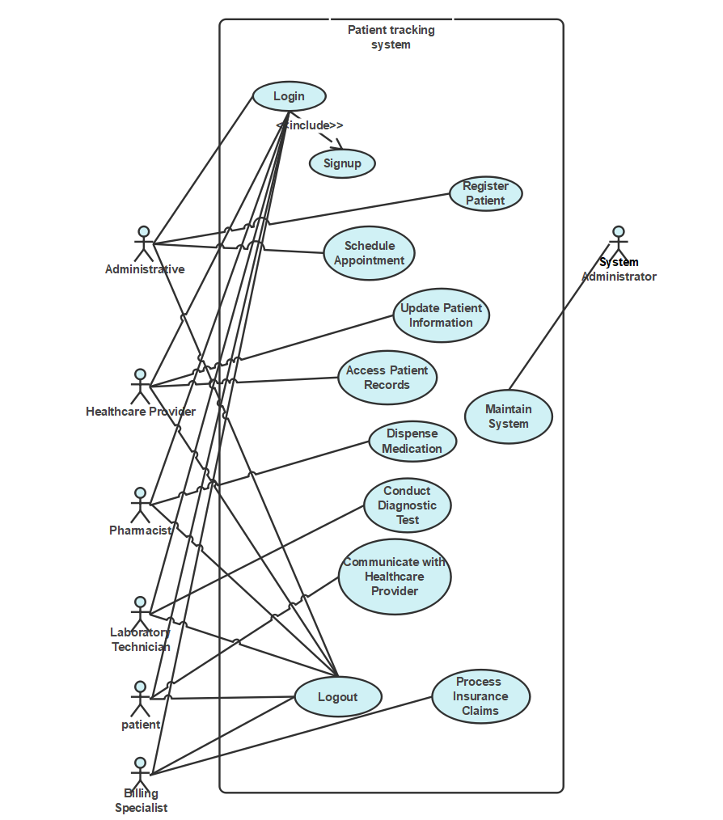
user diagram

Slide 14
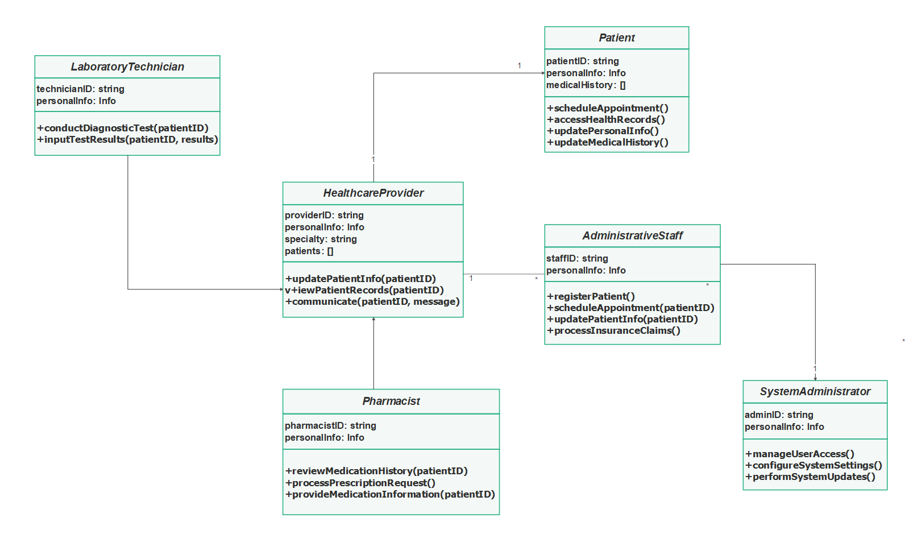
class model

Slide 15
System design
System design is the process of defining the architecture, components, modules, interfaces, and data for a software system to satisfy specified requirements. It involves creating a blueprint or plan that outlines how the patient tracking system will function, perform, and integrate with other systems.
Additionally, it should incorporate security measures to protect patient data and ensure reliable performance even during high-demand periods.

Slide 16
Purpose and goals of the system
The patient tracker system has many goals, some of it are
- intuitive user interface
- Data accuracy and security
- efficient patient management
- seamless integration
The purpose of the patient tracking system is to develop a software system that provides healthcare professionals with an efficient and secure solution for tracking and managing patient information.

Slide 17
Current and Proposed software architecture
current software architecture
The existing manual patient tracking system involves a simple workflow where healthcare professionals manage patient information and appointments manually.
Proposed software architecture
For the patient tracking system, we will adopt a Three-tier architecture. This architecture divides the system into three layers: the presentation layer, the application layer, and the data layer.

